Slide 1

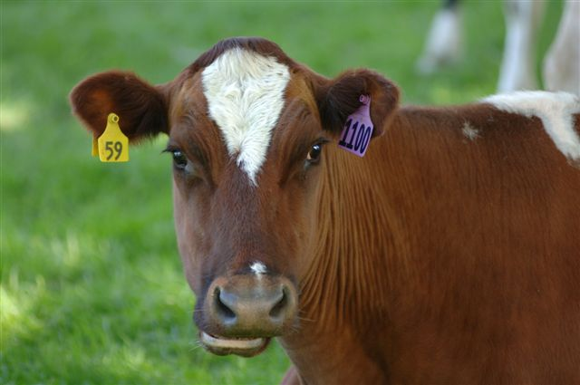
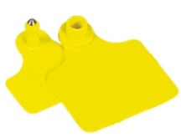
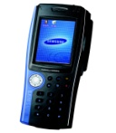
Cattle Tagging Management
SYSTEM SOFTWARE PRESENTATION
By,
Yeap Eng Hwee
Pneu-Logic SEA Sdn Bhd

Slide 2
Project Overview
Cattle Tagging Management System is a system to manage the cattle farm using RFID UHF technology to monitor the daily activities of the cattle in a farm.
Each cattle on the farm is being tagged with a RFID UHF cattle tag which represent the specific cattle using the Tag ID.
The RFID UHF tag will be pierce onto the cattle’s ear as an identity tag for the cattle. The Tag ID will be act as the cattle’s identity to retrieves information and monitor the activities of the cattle.

Slide 3
Project Introduction
The Cattle Tagging Management System will equipped with the features such as :
Store and retrieve the full information of the cattle from the database based on the Tag ID read.
Monitor the movement at entrance and exit of the farm.
Store the vaccination, medication and family history of the cattle.
Set and show alert of the necessary action to be taken on the specific cattle.
Synchronize the database with the RFID UHF handheld device to get the latest and updated information.

Slide 4
Hardware Overview
A RFID UHF reader is used to read the tag and retrieve the full information of the cattle from the database to be display on the PC screen.
The CSL-461 RFID UHF Reader with 4-channel antennas will be used to cater for the requirement of the cattle tagging management system.
For initial stage, one of the antenna (Antenna1) will be placed at the farm entrance and another antenna (Antenna2) will be placed at the farm exit to monitor the in/out movement of the cattle.
The third antenna (Antenna3) will be placed at the registration counter for tag registration. Antenna4 will be reserved for future use.

Slide 5
Hardware Overview
On the other hand, reading a tag from a fix station is not convenient for the farmer since the cow will the scattered around the farm.
In order to solve this, a handheld device with UHF RFID reader is being used to read and retrieve the information from the database.
The handheld reader will be synchronize with the server database before it is being used and will be again synchronize with the server to update the latest information to the database after it is being used.

Slide 6
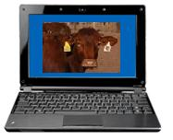
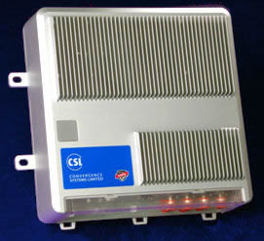
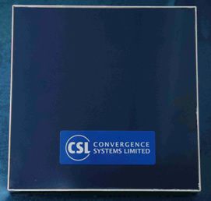

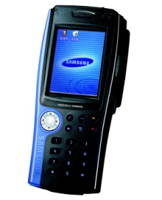
Hardware Overview
CSL 461 UHF Reader
CSL-771 Antenna 1
RJ45
ANT1
Ethernet
PC / Server
Farm’s Entrance
ANT3
ANT2
USB
Wi-Fi /
Bluetooth
CSL-771 Antenna 3
CSL-771 Antenna 2
RFID UHF Handheld Readers
Registration Counter
Farm’s Exit

Slide 7
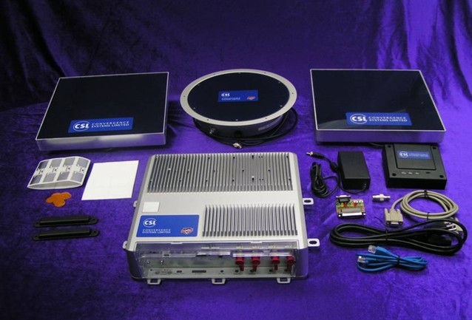
CSL-461 4-Port UHF RFID Fixed Reader

Slide 8
Software Overview
Database is used to store the information of a registered tag and to display the information upon request of the user.
A special user interface will act as the front end of the software to trigger the action requested by the user.
The PC user interface is consist of the following features :
Tag Management – A tab to read/register/remove or edit a tag.
Entrance and Exit Logger – A tab to monitor and log the time of cattle movement when it enters or exits the gate.
Database Viewer – A tab to view the database by using filter and query.
Alert Viewer – A tab to view the alerts set for cattle’s activities.
Sync Handheld – A tab to initiate the synchronization between the PC and the Handheld reader.
General Setting – A setting panel for general parameter.

Slide 9
Information Database
The Information Database will mainly consist of :
Cattle’s Tag ID
Cattle’s Breed
Cattle’s Sex
Cattle’s Date of Birth
Cattle’s Origin
Cattle’s Location
Cattle’s Last In and Last Out Time
Cattle’s 3 Level Pedigree & Generation
Cattle’s Medical History such as Vaccination and Medication History with Date, Purpose, Remarks and Veterinarian Information
Cattle’s Next Alert Time & Alert Remarks

Slide 10
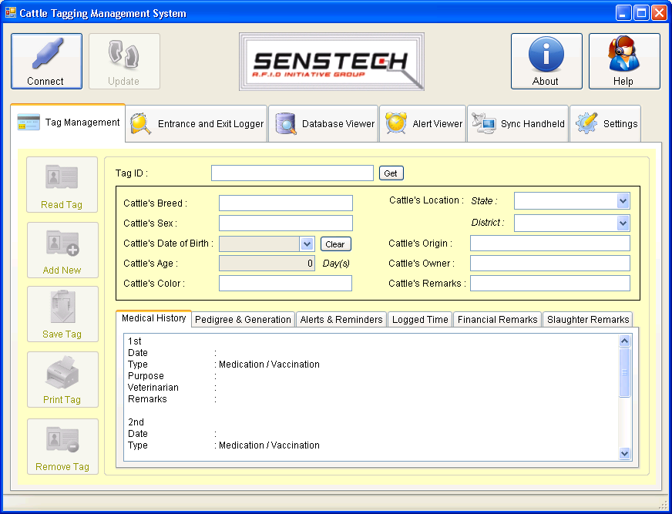
PC User Interface
Main View
Connection to the Reader
Tab Pages

Slide 11
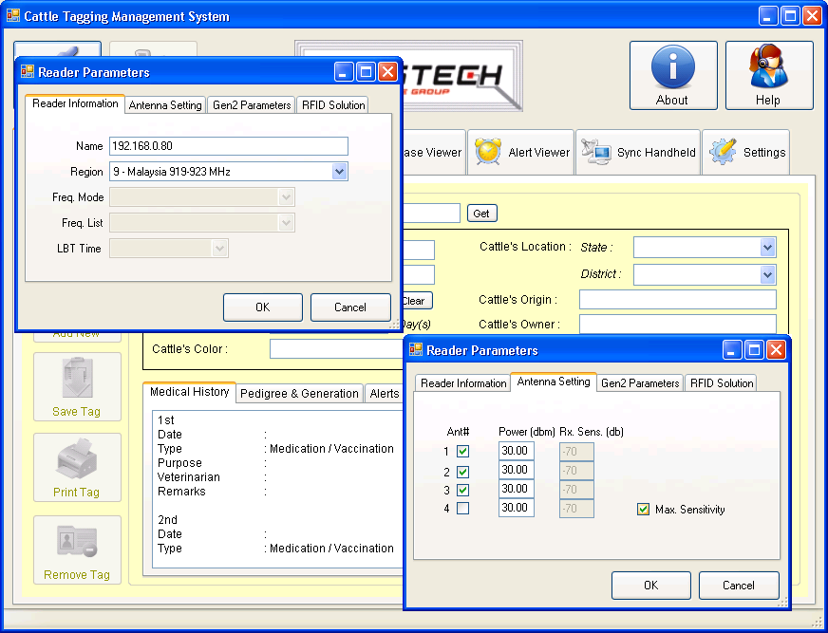
PC User Interface
Reader Connection Setting

Slide 12
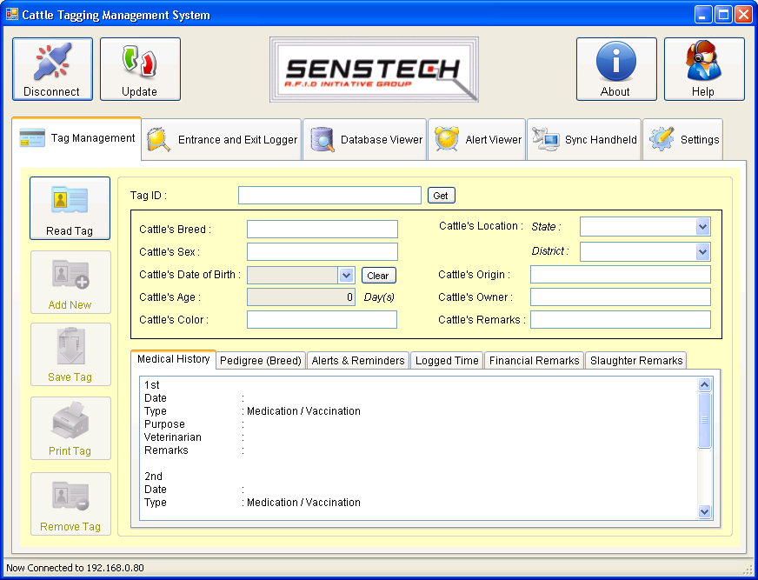
PC User Interface
Some features depending on the connection
will be enabled automatically
Connected View
Connected to the Reader

Slide 13
PC User Interface
Tag Management
Tag Management is use to management a tag such as
reading a tag, register a new tag, edit or remove a tag.

Slide 14
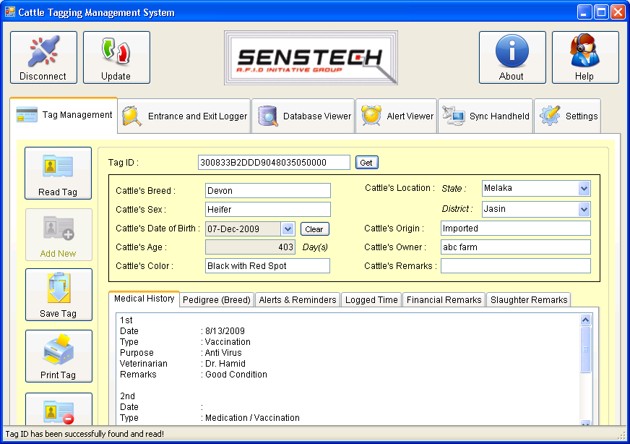
PC User Interface
Tag Management
When an existing tag being read by the reader, it will
automatically display the information of the tag.

Slide 15
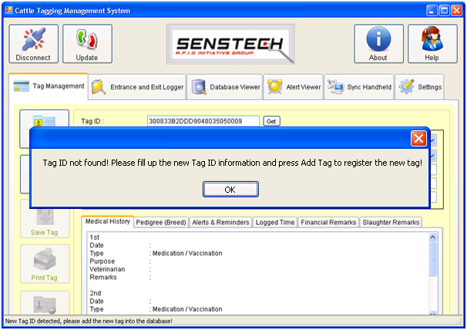
PC User Interface
Tag Management
When a new tag is detected or tag id not found, it indicates
an unregistered tag, register the tag by adding it to the database.

Slide 16
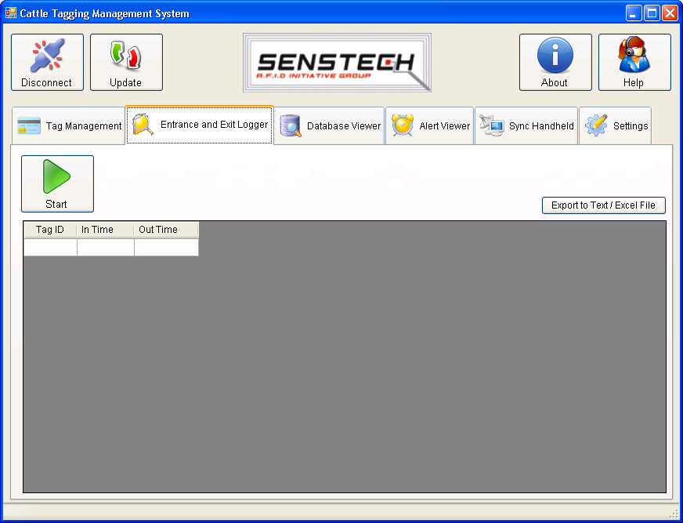
PC User Interface
Logger
Entrance and Exit Logger is used to record and monitor the movement (in/out) of the cattle by creating a time log.

Slide 17
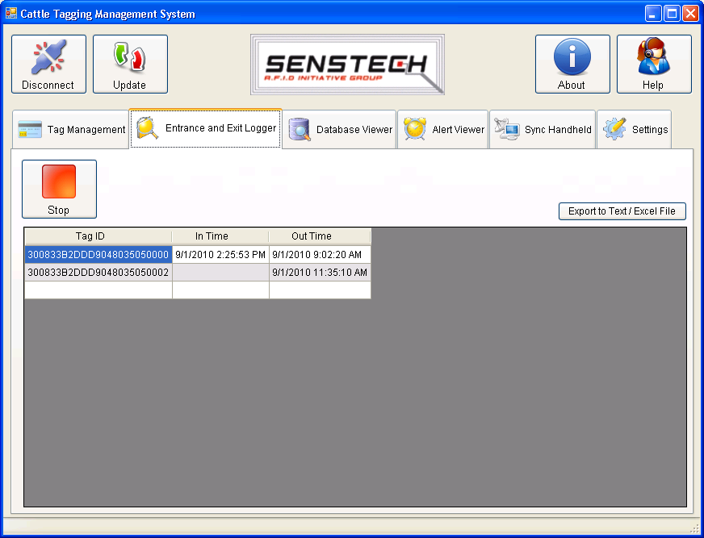
PC User Interface
Logger
The time of entrance and exit of each tag detected is being recorded and logged.

Slide 18
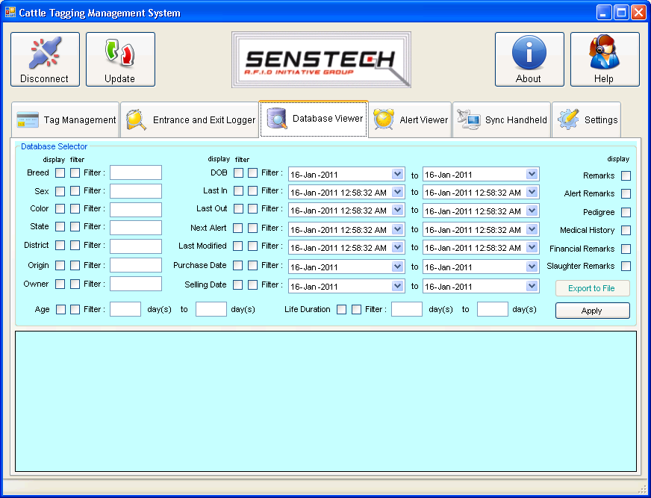
PC User Interface
Database Viewer
Database Viewer is used to retrieve the database information based on the filter and request from the user.

Slide 19
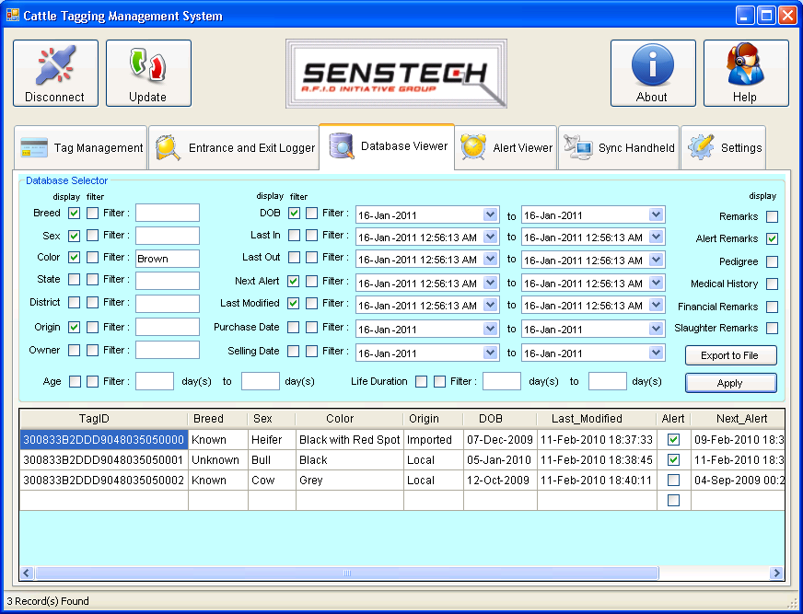
PC User Interface
Database Viewer
Entries is display based on the query and filter entered by the user. The result can be export to excel or text file for analysis.

Slide 20
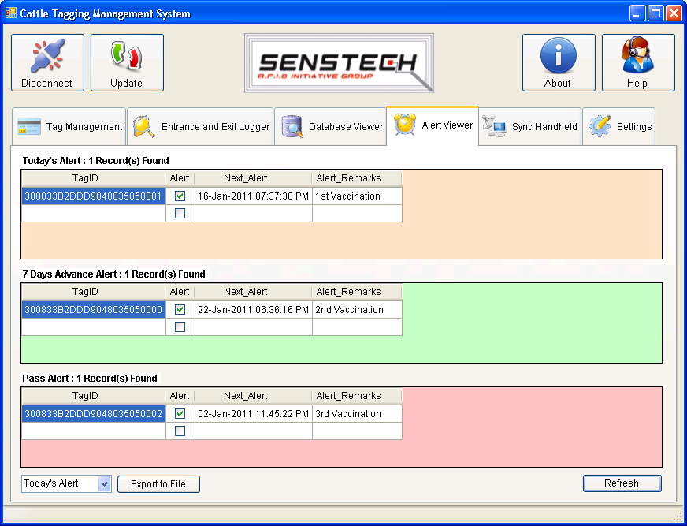
PC User Interface
Alert Viewer
Alert Viewer is used to view the alert set by the user previously for each tag as a reminder for an action to perform on specific cattle.

Slide 21
PC User Interface
Alert Viewer
Alert is being displayed in 3 different boxes (today’s alert, advance alert and pass alert). The data can be export to text or excel file.

Slide 22
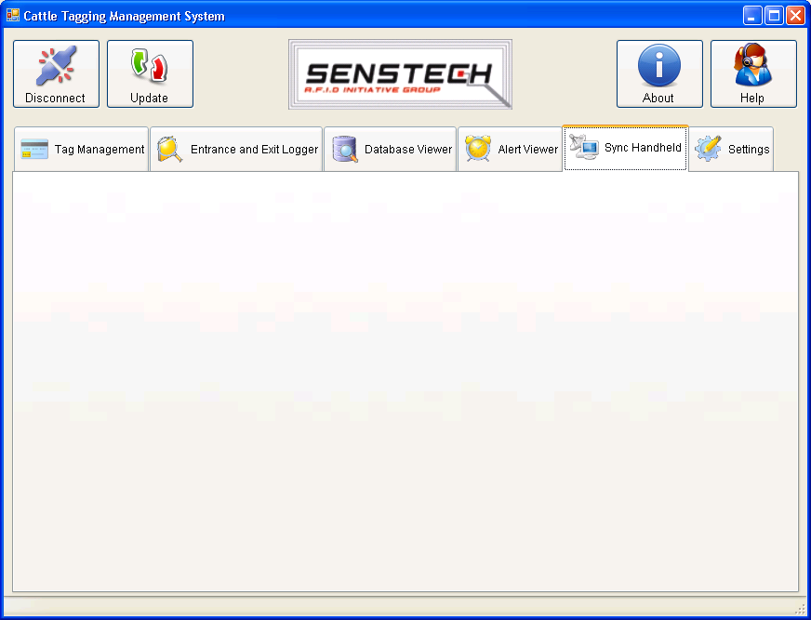
PC User Interface
Other Features
Sync Handheld is used to initiate the synchronization between the PC and handheld reader while settings for general settings. Both features are still under development stages.

Slide 23
Handheld User Interface
The handheld RFID UHF reader is a portable pocket PC build in with the Windows CE and RFID UHF reader.
It will be used to carry around the farm to retrieve the information of the cattle tags by scanning at them using the RFID UHF reader.
The handheld reader should be synchronized with the PC before it is used to get the latest database from the PC.
The handheld user interface allows the user to retrieve the information of the Tag ID and display it on the screen.
The handheld user interface also can be used to edit the information of the tag via the touch screen and save it to the database.
The handheld reader should be synchronized with the PC again once it is finish using for a process to update the database in the PC with the latest changes made.
The handheld user interface is current still under development stage.

Slide 24
Tagging Procedure
New tag is being registered or added into the database using the software. The software is capable to read the tag id via the fixed reader and display the tag id automatically for registration.
User will key in the details information of the cattle based on the tag id and save it to the database.
The tag is then tagged or pierce directly onto the specific cattle’s ear that match the information keyed in.

Slide 25
Tagging Procedure
By using the portable handheld reader that have been synchronized with the updated database from the PC, the handheld reader is capable to read the tag and display the information of the cattle directly on the screen of the device remotely.
User might able to key in new information or update the information via the handheld reader.
After updating the information, the handheld will be sync with the PC to update the changes made and keep the main database updated for next use.

Slide 26

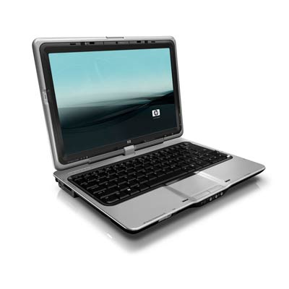
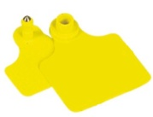

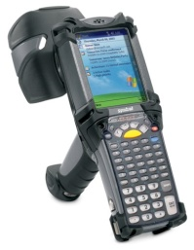
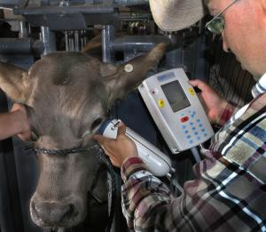
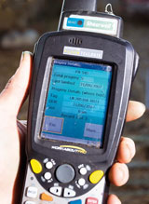
Tagging Procedure Overview
1. Adding New Tags to database.
2. Tags are being tagged on the cattle.
6. Updated database will be sync to PC for next use.
3. Handheld grabbed the latest database from PC.
4. Reading information via the tag using handheld reader.
5. User add & edit the information from the handheld device.

Slide 27
Entrance and Exit Logger Procedure
The entrance and exit of the farm are being fixed with the one antenna each which connected to the reader to read any tag passed by.
Antenna1 connected to reader’s port 1 is being fixed at the farm’s entrance to monitor the movement of cattle entering the farm while Antenna 2 connected to reader’s port 2 will be fixed at farm’s exit to monitor the movement of cattle leaving the farm.
The logger will record and log the last in time and last out time for each of the tag detected.

Slide 28
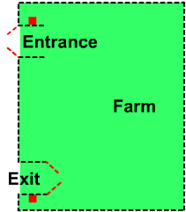
Entrance and Exit Logger Overview
Fixed readers will be installed at the entrance and exit of a farm.
When the gate of exit is opened, each cattle’s tag that went through the Exit path will be read and recorded with the specific time.
When the gate of entrance is opened, each cattle’s tag that went through the Entrance path will read and recorded.
This data is then manipulated by the system for records and analysis.

Slide 29
Development Plan Automatic Scanning Door
Automatic Scanning Door Overview
The automatic scanning door is a door or path fixed with RFID readers where each cattle has to pass through everyday.
The purpose of the door is to scan each cattle information and to inform the farmer which cattle is ready to be slaughtered, milking or vaccination by referring to the cattle history and setting by the farmer.
This system can be a standalone door in the farm or it can be integrated together with the Cattle Tagging Management System.

Slide 30
THANK YOU!

